Slide 1
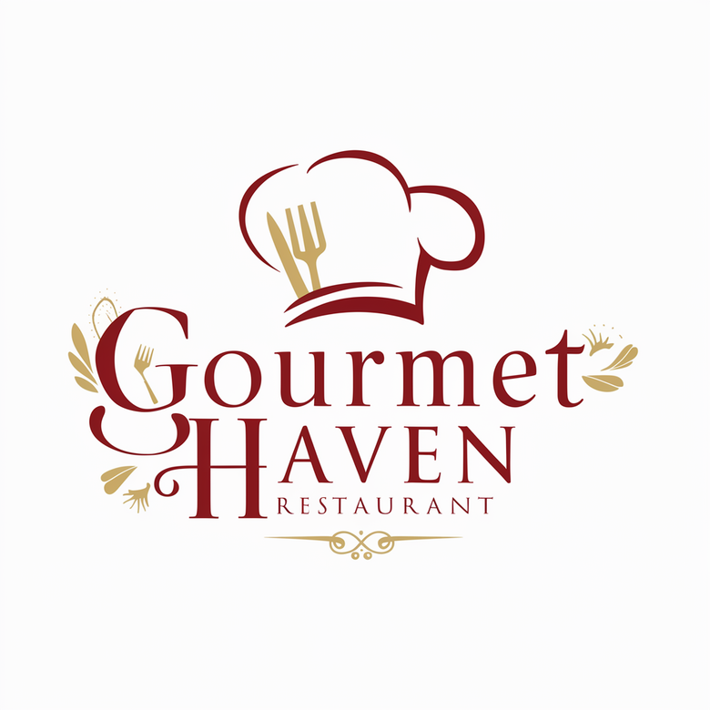
Maximizing Profits through More Efficient Ad Spending
Chris Crown, Dylan Beers and Connor Hill

Slide 2
Gourmet Haven Needs to Increase the Effectiveness of Marketing Campaigns
14%
Response
Business Solutions from Data Analysis

Slide 3
Gourmet Haven Collects Customer Data

Slide 4
Gourmet Haven Collects Customer Data
Meats/Fish

Slide 5
Gourmet Haven Collects Customer Data
Meats/Fish
Fruits/Sweets

Slide 6
Gourmet Haven Collects Customer Data
Meats/Fish
Fruits/Sweets
Premium/Wine

Slide 7
Gourmet Haven Collects Customer Data
Meats/Fish
Fruits/Sweets
Premium/Wine
Marital Status

Slide 8
Gourmet Haven Collects Customer Data
Meats/Fish
Fruits/Sweets
Premium/Wine
Marital Status
Education

Slide 9
Gourmet Haven Collects Customer Data
Meats/Fish
Fruits/Sweets
Premium/Wine
Marital Status
Education
Income

Slide 10
Data can be turned into a model to make business predictions/decisions

Slide 11
Data can be turned into a model to make business predictions/decisions

Slide 12
Data can be turned into a model to make business predictions/decisions

Slide 13
Data can be turned into a model to make business predictions/decisions

Slide 14
Data can be turned into a model to make business predictions/decisions

Slide 15
Effective Marketing Saves Money and Makes Money

Slide 16
We can Leverage Customer Insights from your Most Recent Campaign
01
02
03
04
Lowers Customer Acquisition Costs
Improves Conversion Rates
Targets your spending
By Understanding your Customers

Slide 17
We can Leverage Customer Insights from your Most Recent Campaign
01
02

Slide 18
We can Leverage Customer Insights from your Most Recent Campaign
01
02
03
Lowers Customer Acquisition Costs

Slide 19
We can Leverage Customer Insights from your Most Recent Campaign
01
02
03
Lowers Customer Acquisition Costs
Improves Conversion Rates

Slide 20
We can Leverage Customer Insights from your Most Recent Campaign
01
02
03
Lowers Customer Acquisition Costs
Improves Conversion Rates
Targets your spending

Slide 21
We can Leverage Customer Insights from your Most Recent Campaign
01
02
03
04
Lowers Customer Acquisition Costs
Improves Conversion Rates
Targets your spending
By Understanding your Customers

Slide 22
Your most receptive customers…
Single
No Kids
Purchase more Meat
Purchase more Wine/Gold Products

Slide 23
A Two Pronged Approach

Slide 24
A Two Pronged Approach
Your Current Customer Database

Slide 25
A Two Pronged Approach
Your Current Customer Database
Describing how your current customers are behaving. Match marketing with good fits

Slide 26
A Two Pronged Approach
Attract New Customers
Your Current Customer Database

Slide 27
A Two Pronged Approach
Attract New Customers
Your Current Customer Database
Predict Behavior. Who do we target?

Slide 28
A Two Pronged Approach
Attract New Customers
Your Current Customer Database
Predict Behavior. Who do we target?

Slide 29
Current Customers

Slide 30
Current Customers
Recent purchases, meat/wine/gold products, in-store shopping all matter

Slide 31
Current Customers
Focus local/in-store advertising for meat and fish
Recent purchases, meat/wine/gold products, in-store shopping all matter

Slide 32
Current Customers
Focus local/in-store advertising for meat and fish
Send targeted marketing to customers who spend a lot on Gold Products. We suggest some type of in-store rewards program or special access to VIP events/tastings.
Recent purchases, meat/wine/gold products, in-store shopping all matter

Slide 33
Current Customers
Focus local/in-store advertising for meat and fish
Send targeted marketing to customers who spend a lot on Gold Products. We suggest some type of in-store rewards program or special access to VIP events/tastings.
Offer frequent-buyer deals/discounts
Recent purchases, meat/wine/gold products, in-store shopping all matter

Slide 34
Current Customers
Focus local/in-store advertising for meat and fish
Send targeted marketing to customers who spend a lot on Gold Products. We suggest some type of in-store rewards program or special access to VIP events/tastings.
Offer frequent-buyer deals/discounts
Offer start up deals and high levels of brand familiarization to newly added customers
Recent purchases, meat/wine/gold products, in-store shopping all matter

Slide 35
Current Customers
Focus local/in-store advertising for meat and fish
Send targeted marketing to customers who spend a lot on Gold Products. We suggest some type of in-store rewards program or special access to VIP events/tastings.
Offer frequent-buyer deals/discounts
Offer start up deals and high levels of brand familiarization to newly added customers
Offer a loyalty program to customers at the 10 month mark
Recent purchases, meat/wine/gold products, in-store shopping all matter

Slide 36
Retain frequent high-spenders

Slide 37
Retain frequent high-spenders
Keep them coming into brick and mortar stores

Slide 38
Retain frequent high-spenders
Keep them coming into brick and mortar stores
Reduce customer churn by keeping the continuously engaged with our marketplace

Slide 39
Attracting New Customers

Slide 40
Attracting New Customers
Target ads and fix the website

Slide 41
Attracting New Customers
Use diversified online marketing tactics to seek out potential buyers who are interested in meat and wine
Target ads and fix the website

Slide 42
Attracting New Customers
Use diversified online marketing tactics to seek out potential buyers who are interested in meat and wine
Further filter down to families without kids and single-member households
Target ads and fix the website

Slide 43
Attracting New Customers
Use diversified online marketing tactics to seek out potential buyers who are interested in meat and wine
Further filter down to families without kids and single-member households
Use click-analysis and drop-off rates to investigate why the website does not convert
Target ads and fix the website

Slide 44
Attracting New Customers
Use diversified online marketing tactics to seek out potential buyers who are interested in meat and wine
Further filter down to families without kids and single-member households
Use click-analysis and drop-off rates to investigate why the website does not convert
Optimize the website
Target ads and fix the website

Slide 45

We have developed a marketing strategy that we will share with your team
Technical aspects can be explained further in the technical presentation

Slide 46

Using Data, Gourmet Haven has the Potential for Increased Profits
Thank You
Chris, Dylan and Connor

Slide 47
Data Solutions for Gourmet Haven
A deeper dive into data practices, model building and evidence-based business insights

Slide 48

Outline and Goals
Cleaning | Processing | Model Choice | Insights
Granular Investigation | Class Balancing | XGBoost | SHAP Analysis

Slide 49
Data Cleaning

Slide 50
Case Study - Terry

Slide 51
Case Study - Terry
An amalgam of types of problems we found in this data:

Slide 52
Case Study - Terry
An amalgam of types of problems we found in this data:
121 years old

Slide 53
Case Study - Terry
An amalgam of types of problems we found in this data:
121 years old
Lives with a teen

Slide 54
Case Study - Terry
An amalgam of types of problems we found in this data:
121 years old
Lives with a teen
Buys luxury wines/meats

Slide 55
Case Study - Terry
An amalgam of types of problems we found in this data:
121 years old
Lives with a teen
Buys luxury wines/meats
$1730 year

Slide 56
Case Study - Terry
An amalgam of types of problems we found in this data:
121 years old
Lives with a teen
Buys luxury wines/meats
$1730 year
Unknown marital status

Slide 57
Cleaning Up Terry
Duplicate Row Search
Null/Checks
Median Imputation
Mode imputation
“Ridiculous Value” Filters

Slide 58
Terry Could Theoretically Exist!

Slide 59
Terry Could Theoretically Exist!

Slide 60
Data
Preprocessing

Slide 61
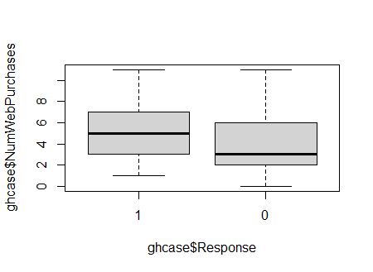
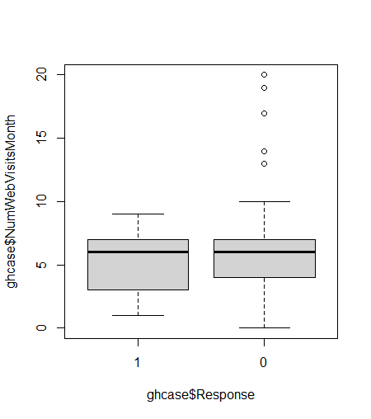
High Level Analysis
Before any modeling we wanted to try identify some key insights about the difference between those who responded to our campaign and did not

Slide 62
Feature Binning
To create more actionable/easily interpretable data:
Ed_Level
Marital_Level
Dependents

Slide 63
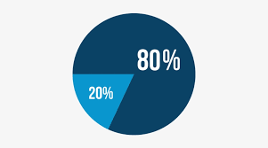
Data Partitioning
80/20 Split
Due to low (<1%) NA values, we conducted data imputation before partitioning
Easier to work with SMOTE/Feature Design
Minimal Data Leakage

Slide 64
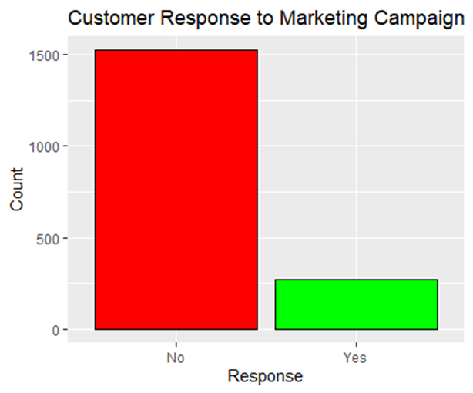
SMOTE - Balance Classes
To reduce inherent model bias toward the majority class:
Operates by creating synthetic samples
Seeks k nearest neighbors from minority class
Takes difference b/w feature values, multiplies by a random # from 0-1, added back in
Augments minority class and rectifies imbalance

Slide 65
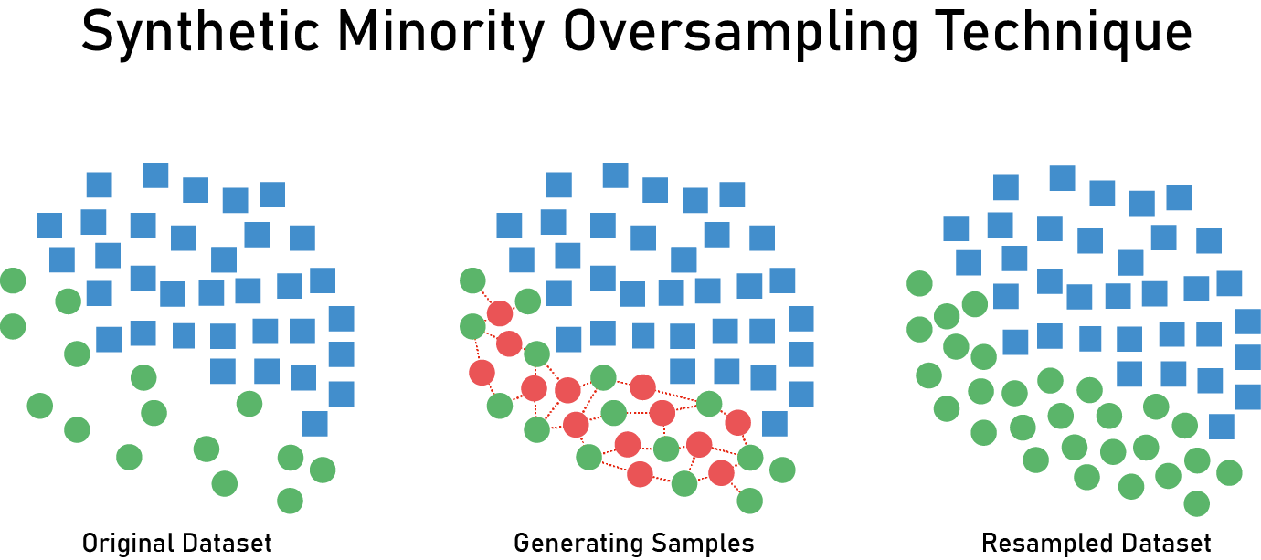
SMOTE - Proactively Avoid Hi-Variance
To reduce model bias toward the majority class:
Enables ML models to learn and generalize better
Provides a richer and more diverse dataset compared to replication
Capture underlying complexities – in an effort to avoid misclassifying the minority class

Slide 66
Model Choice

Slide 67
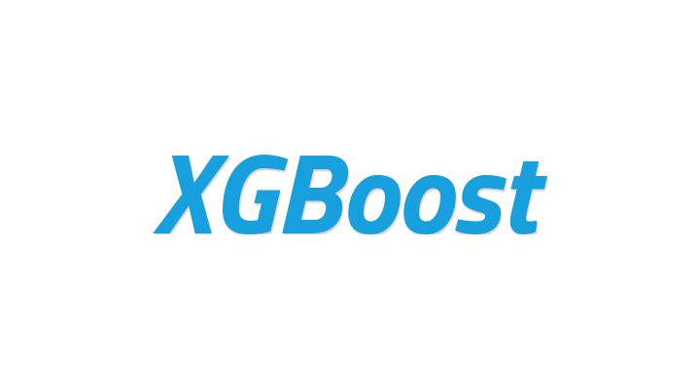
XGBoost - Our Best Option
After running Subset Selection/LASSO/RF models:
Optimized variant of gradient-boosted algorithm
Reduces bias compared to other top contender - RF
Hoping SMOTE will remedy bias tradeoff in variance increases

Slide 68
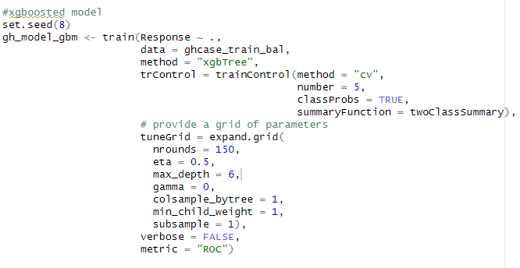
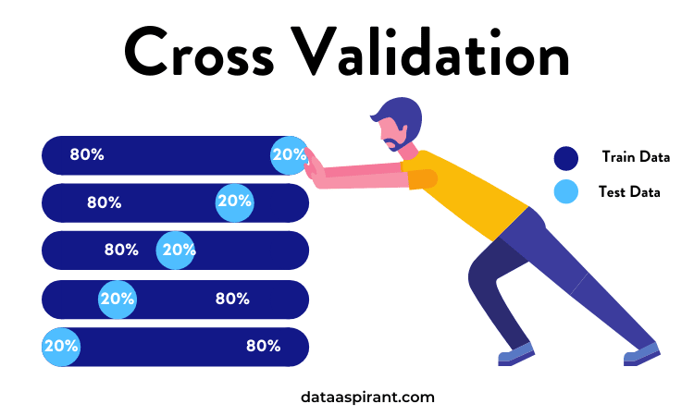
XGBoost - Tuning Hyperparameters
Cross Validation
Extensive Tuning Grid
The risks of over-tuning
Simulated “Validation Set” Rationale
Eta - slow = better generalization
Max_depth - moderate model complexity
Gamma - skipped due to high model performance
Colsample… - fraction of feature sampling
Min_child… - node splitting
Subsample - fraction of training data per tree

Slide 69
XGBoost - Tuning Hyperparameters
Cross Validation
Extensive Tuning Grid
The risks of over-tuning
Simulated “Validation Set” Rationale
We were able to tune for higher AUC’s but we risked overfitting the data for only marginal AUC increases

Slide 70
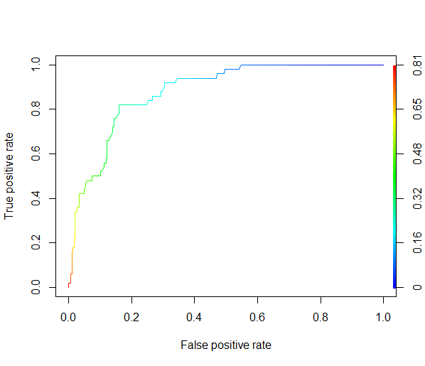
AUC = 0.910

Slide 71
Insights

Slide 72
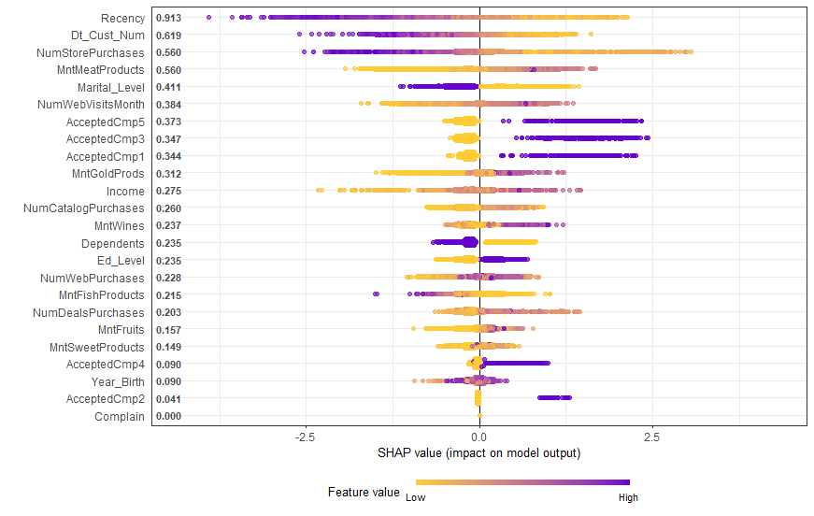
SHAP Plots help to visualize predictor contribution
Notes:
Beeswarm plots like this one are information-dense and provide a broad overview of SHAP values for many features at once. However, to truly understand the relationship between a feature’s values and the model’s predicted outcomes, it is necessary to examine dependence plots

Slide 73
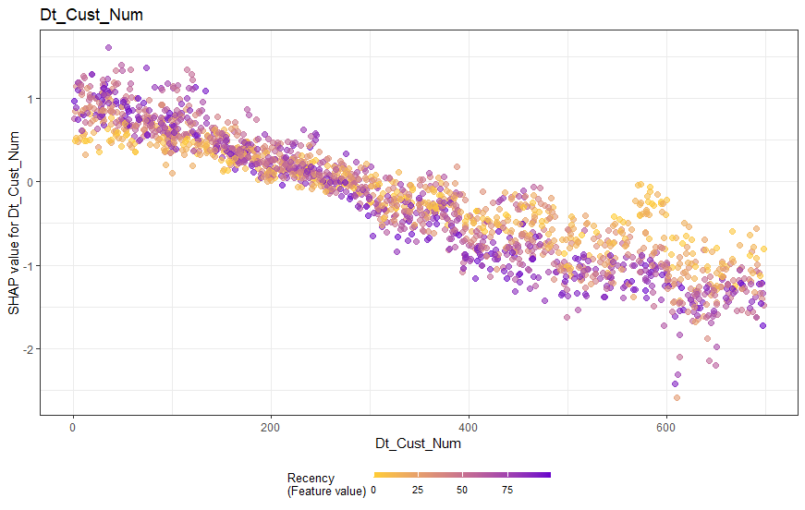
Recently added customers need more nurturing (brand familiarity) to respond well to marketing campaigns
Market a Loyalty Program at a customer’s 10-month membership mark

Slide 74
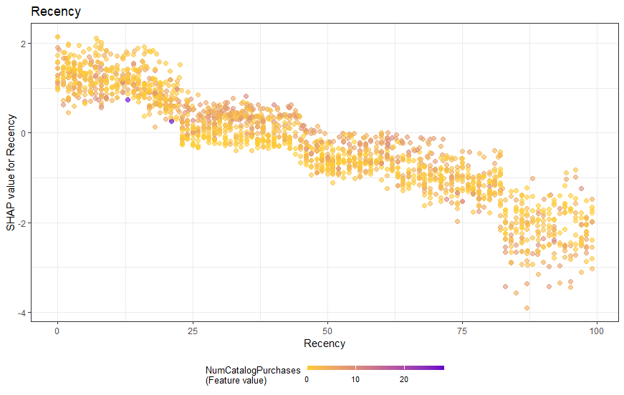
Recent Customers are more valuable for model predictions
Notes:
The vertical dispersion in SHAP values seen for fixed variable values is due to interaction effects with other features. This means that an instance's SHAP value for a feature is not solely dependent on the value of that feature, but is also influenced by the values of the instance's other features.

Slide 75
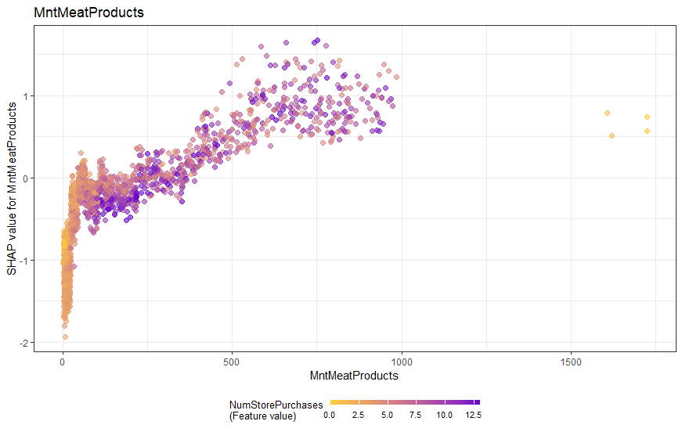
Customers tend to buy their meat from the store, and this strongly influences model predictions

Slide 76
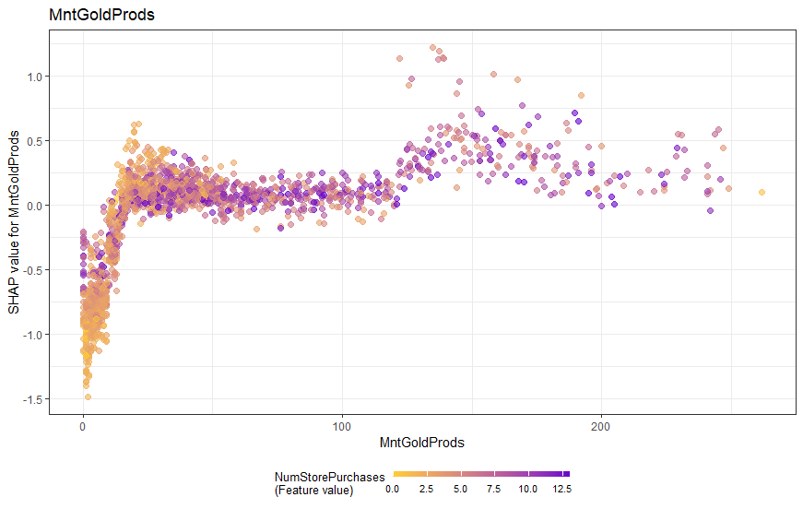
Brick and Mortar Shopping Matters - a possible segmentation strategy
Implement a Premium Products Rewards Program and offer VIP In-Store Events to retain top spenders within the program
Notes:
Customers who spend a lot on premium goods and buy frequently in-store tend to have a strong influence on the model. We suggest some type of rewards/loyalty program or VIP in-store events to retain these customers. Like Binny’s tastings

Slide 77
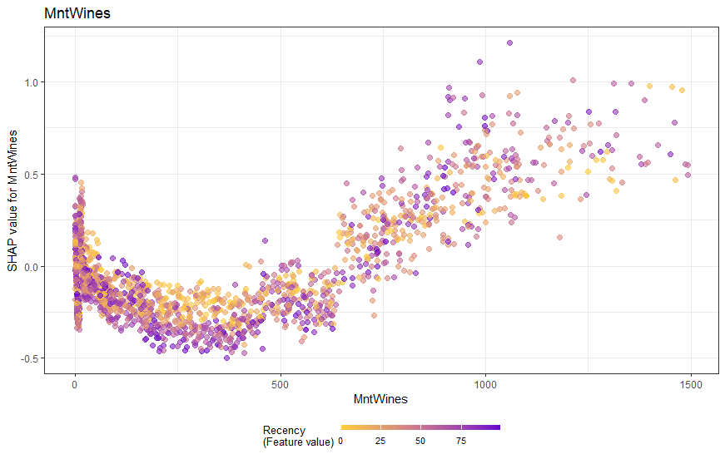
Focus marketing on re-engaging recent high spenders on wine

Slide 78
Marketing Options
01
02
03
04
Paid Search - Keyword Lists
Display - Banner Ads
Demand Gen - Email Lists

Slide 79
Areas to Improve our Marketing
Collect Location Data
Use purchase history
Recurring purchases
Competitor Research

Slide 80
Our model reduces bias, remedies variance and captures potential sales
Thank You
Chris, Dylan and Connor

